Slide 1
Dynamic Braking System controlled by software
Yasin Arafat
Technische Universität Chemnitz
Master Automotive Software Engineering
10^{nth} semester

Slide 2
Outline
Motivation
State of the art of detecting object with Camera sensor
Concept
Experimental results
Conclusion
References

Slide 3
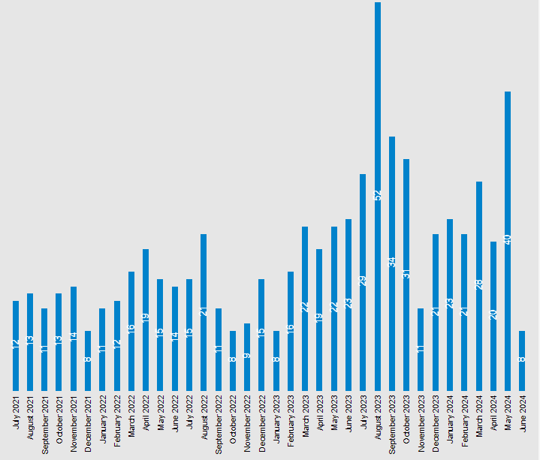
Motivation
Autonomous Driving System (ADS) is driving a vehicle with automotive sensors and software without controlling by human. Because of that lot of accidents happened every month fig 1.
Objective:
To run machine learning object detection algorithm on an embedded system.
A self-driving automobile can keep the ideal distance between objects in any circumstance.
Implementing dynamic braking system.
ADS-equipped vehicles Crashes [1]

Slide 4
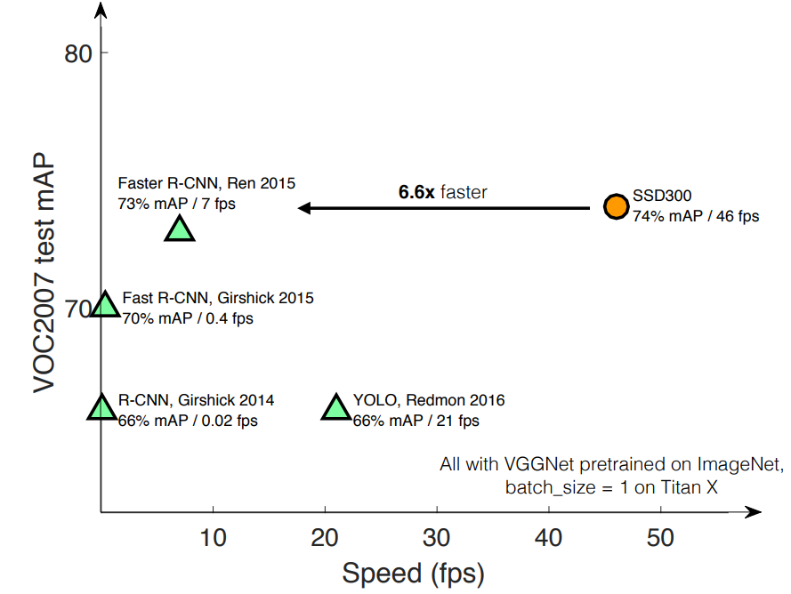
State of the art of detecting objects
There are two types of method to detect objects.
One is old traditional method such as edge detection, corner detection, and template matching etc.
Other one is deep learning method such as Faster-RCNN, Yolo, Mobilenet-SSD etc.
Comparison among different deep learning object detecting algorithm [2]

Slide 5
Concept
MobileNetSSD is a lightweight convolutional neural network architecture designed for mobile and embedded devices. So, Raspberry Pi 5 uses Mobilenetv3-ssd for object detection in order to achieve a modest level of accuracy and speed.
Adaptive cruise control (ACC) is used to maintain safe distance between detected objects.
To brake a car with program,
Identify the position of object.
Calculate distance between car and detected object.
Current speed of the car.
Then Apply this formula,
de_accelerate = (current_speed * current_speed) / ( 2 * distance_from_object)
# v2 = u2 + 2as -> a = -u2 / 2s, here v is zero

Slide 6
Experimental results
The COCO dataset contains challenging, high-quality visual datasets for computer vision, mostly state-of-the-art neural networks. For example, COCO is often used to benchmark algorithms to compare the performance of real-time object detection.
The performance trade-offs as a function of multiplier and resolution.
 | i7 14600 & RTX 4070 Super | RPi5 4GB | RPi5 4GB | RPi5 4GB
FPS | 18-25 | 2-3 | 10-12 | 18-20
Camera Height & Width | 640 x 480 | 640 x 480 | 640 x 480 | 640 x 480
Speed | Very Fast | Slow | Medium | Fast
Resolution | 500 x 500 | 500 x 500 | 300 x 300 | 198 x 198
Cost | Approx. $1200 | $90 | $90 | $90
Comparison among different embedded systems in real time with COCO datasets using pretrained large MobileNetV3-SSD model to detect objects

Slide 7
Conclusion
The testing results show that MobileNetSSD works effectively with inexpensive embedded devices, exhibiting respectable accuracy and performance.
Implementing parallel programming and calibrating the camera in the future can enhance performance and accuracy.
Maintain a safe distance from the vehicle ahead.
When braking is necessary, apply the brakes by using newton motion law.
Notes:
As we can see from experimental result, MobileNetSSD performs well with low budget embedded device with decent accuracy and speed

Slide 8
References
[1]
[2]
NHTSA (n.d.). Standing General Order on Crash Reporting | NHTSA. [online] www.nhtsa.gov. Available at: https://www.nhtsa.gov/laws-regulations/standing-general-order-crash-reporting.
“SSD : Understanding Single Shot Object Detection.” Manal El Aidouni, 25 June 2019, manalelaidouni.github.io/Single%20shot%20object%20detection.html.

